Slide 1

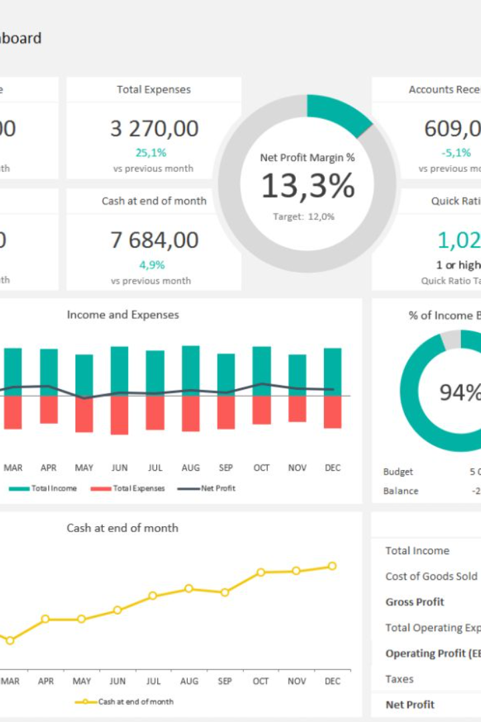
Personal Finance Dashboard
Created an interactive Power BI dashboard to provide comprehensive insights into financial health. Utilized data acquisition and conversion techniques to transform datasets and developed visually appealing visualizations.
Through this dashboard, users can gain valuable insights into key financial metrics such as net worth, income, spending, and savings. The structured format for datasets ensures accurate and efficient data analysis, while visually appealing visualizations make it easy to understand and interpret the financial data.

Slide 2
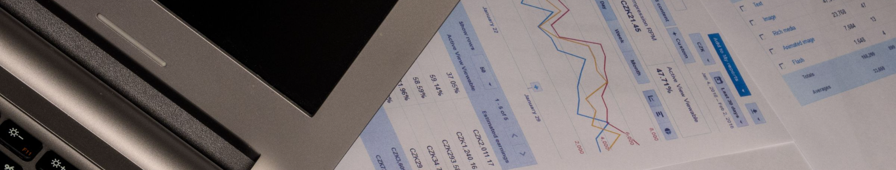
Introduction
The Personal Finance Dashboard project aimed to provide individuals with a powerful tool to gain insights into their financial health.
The project involved the acquisition and conversion of sample datasets, which were transformed into an interactive dashboard using Power BI.
The dashboard offered comprehensive visualizations and analysis on key financial metrics, including net worth, income, spending, and savings.

Slide 3
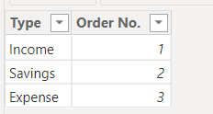
Data Acquisition and Conversion Techniques
Explore the methods used to gather financial data from various sources and how it's converted into a unified format for analysis.
The whole of the Data is been categorized into three type of Categories,
Income
Savings
Expense

Slide 4

Structured Format for Datasets
Explain the importance of organizing the financial data into a structured format, enabling easy interpretation and analysis.
This step likely involved gathering sample datasets from various sources like bank statements, income records, expense details, and savings information. These datasets were then converted into a format compatible with Power BI.
Utilizing Power BI's capabilities, the project involved designing an interactive dashboard interface. This dashboard would have included multiple visualizations, charts, and graphs to represent key financial metrics.

Slide 5
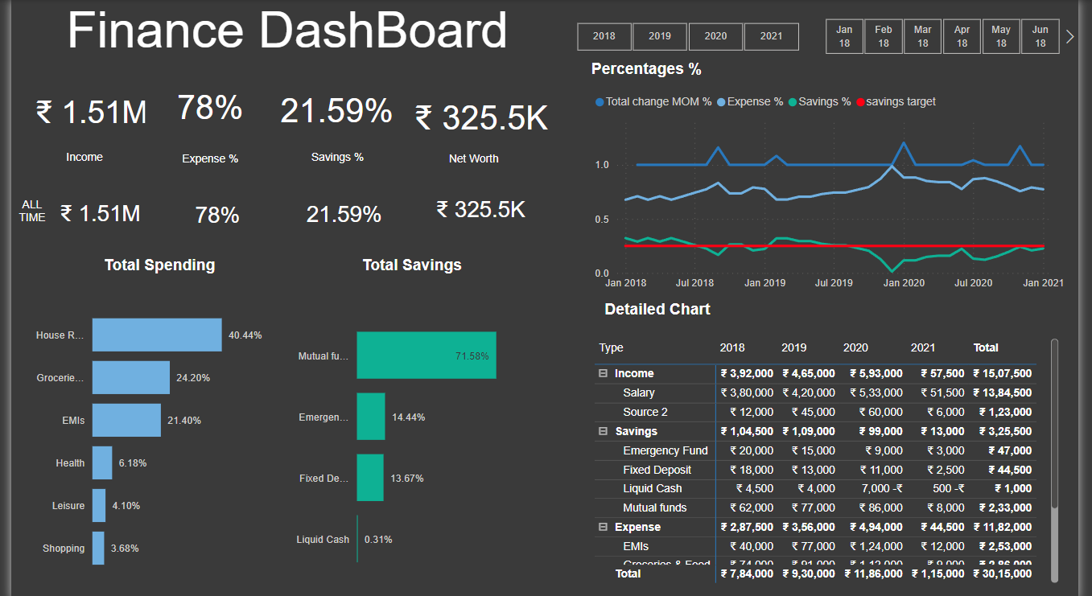
Developing Visually Appealing Visualizations
Showcase the visually stunning visualizations created to effectively communicate complex financial information to users.

Slide 6
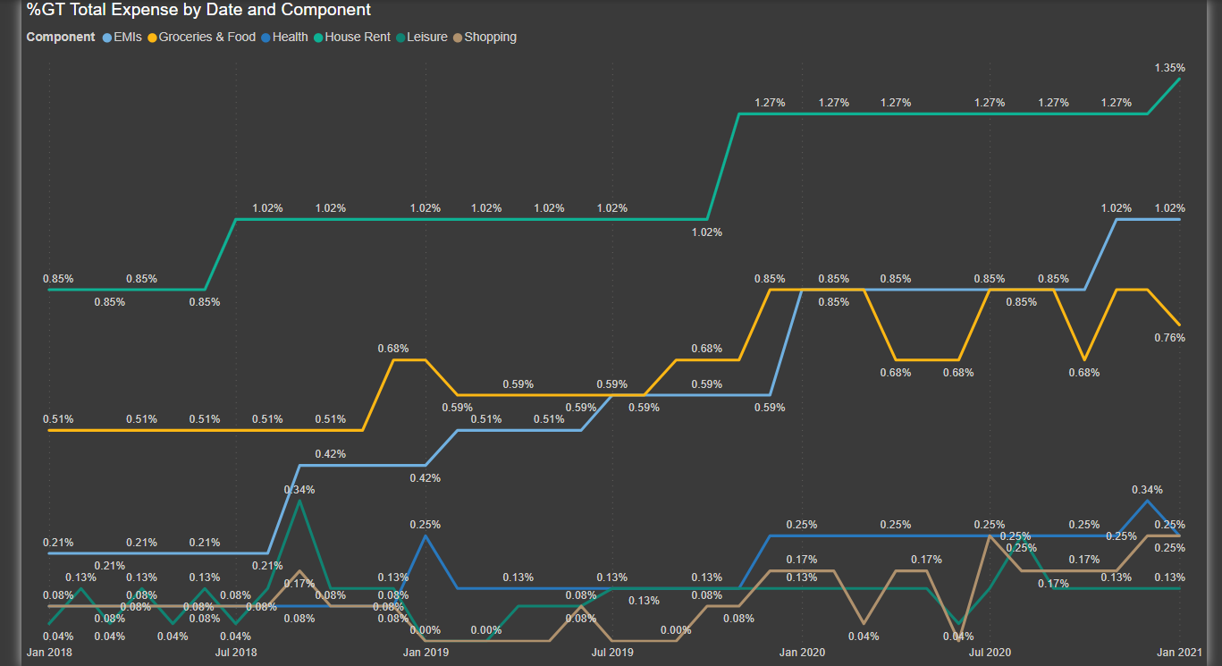

Slide 7

Analyzing Key Financial Metrics
Highlight the key financial metrics that are analyzed within the dashboard, such as net worth, income, spending, and savings.
Net Worth: Aggregated view of assets and liabilities, giving users an overview of their financial standing.
Income Analysis: Visualization of income sources, patterns, and trends over time.
Spending Analysis: Categorized breakdown of expenses, enabling users to identify where their money is being spent.
Savings Overview: Insights into savings rate, goals, and progress towards financial objectives.

Slide 8
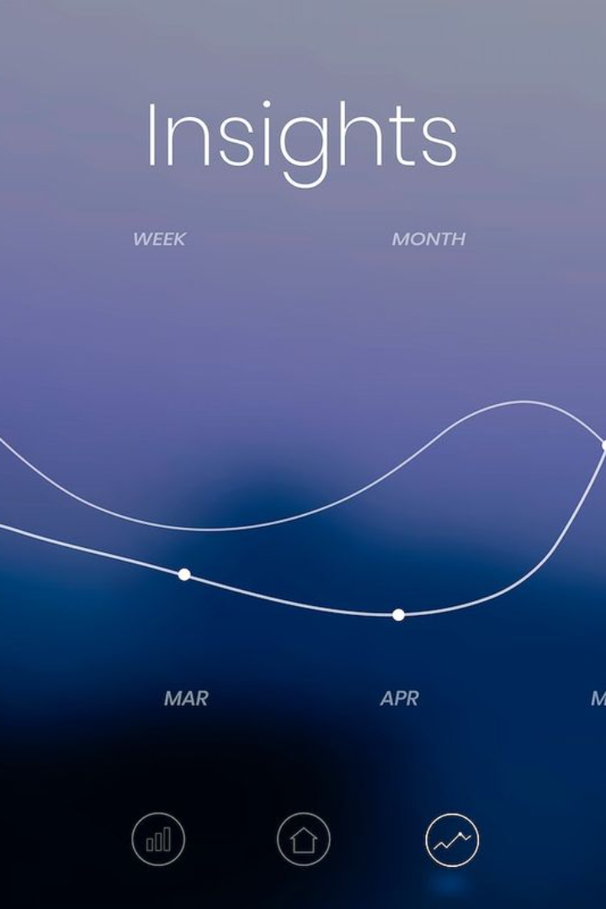
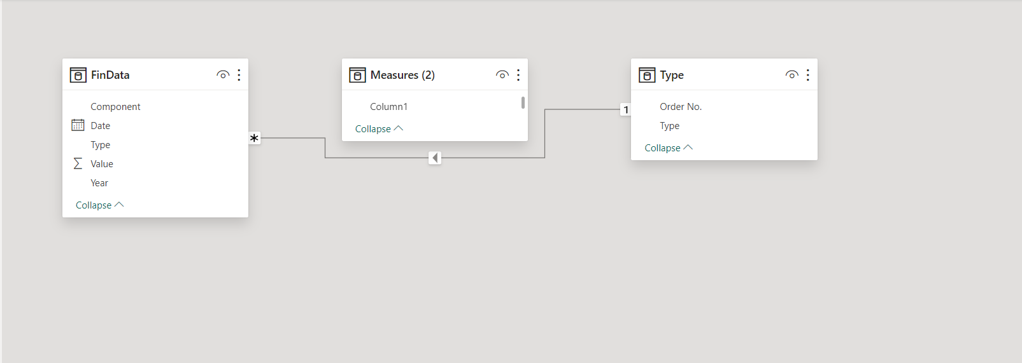
Uncover the Secrets of Wealth: Net Worth, Income, Spending, and Savings
Embark on a thrilling exploration of our personal finance dashboard, where you'll unveil fascinating insights, discover trends, and unlock the power to compare income to expenses. Track your progress towards financial goals and embark on a journey towards financial freedom like never before!

Slide 9
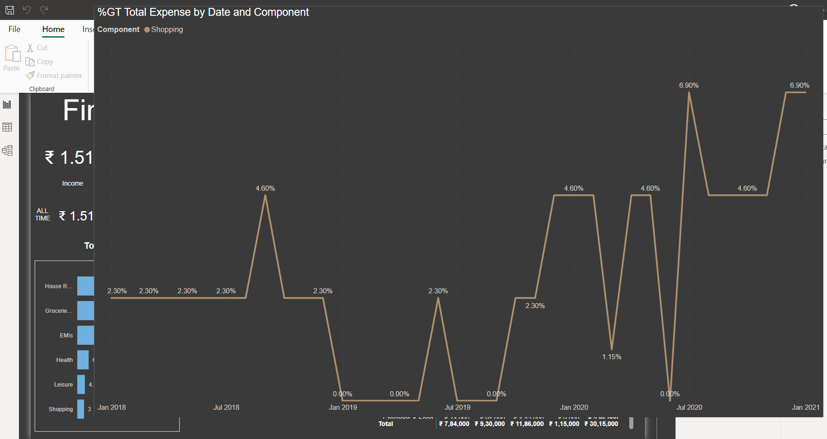
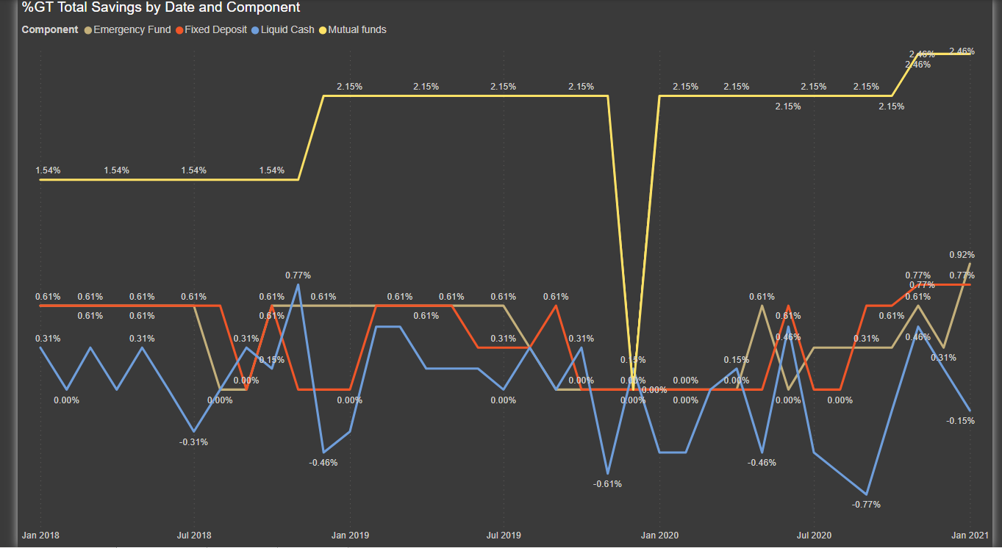
Conclusion
The aim of this project seems to empower individuals by providing them with actionable insights into their financial health, facilitating better financial decision-making and planning.

